Slide 1
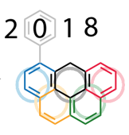


How to Become Famous
(with Organic Chemistry)
2 + ? = 4
Igor Alabugin,
Florida State University,
July 23, 2024

Slide 2
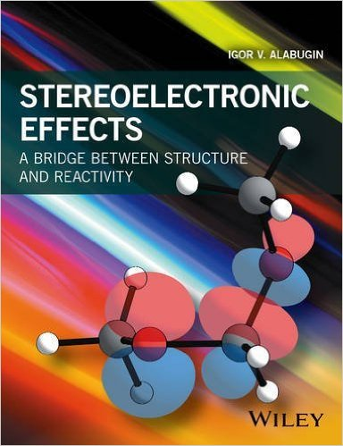

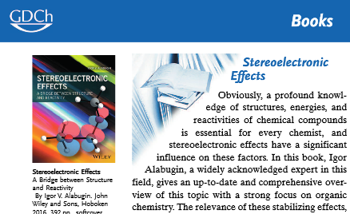
The main questions
of chemistry:
How to make a bond?
How to break a bond?
“This book is highly recommended to every chemist and particularly to every student…” Angew. Chem. Int. Ed. 2017, 56, 2.
Notes:
To students in the audience that I obviously care about it so much
The yin/yang of chemistry
The synergy of cyclizations and fragmentations – what does it mean? Two main questions in chemistry:
We will narrow the focus a little bit and concentrate on cycles (>90% of molecules that we know have a cycle!). Furthermore, most of molecules that we don’t know ALSO have a cycle
The importance of fragmentations –
Build conceptual bridges between different functional groups, adjust oxidation level, aromatize, remove directing groups after they have served their purpose, etc etc

Slide 3
How not to be wrong
Let’s take a quiz!
Circle the more stable structure in these pairs
Circle the stronger bond in the two pairs
Notes:
As most of other talks on reactions, I will be asking the two eternal questions of chemistry. I always ask them and recently wrote a book where I tried to answer these questions to the best of my ability. But today I will narrow this talk to discussion of bond making and breaking in the context of cyclization reactions
The synergy of cyclizations and fragmentations – what does it mean? Two main questions in chemistry:
We will narrow the focus a little bit and concentrate on cycles (>90% of molecules that we know have a cycle!). Furthermore, most of molecules that we don’t know ALSO have a cycle
The importance of fragmentations –
Build conceptual bridges between different functional groups, adjust oxidation level, aromatize, remove directing groups after they have served their purpose, etc etc

Slide 4

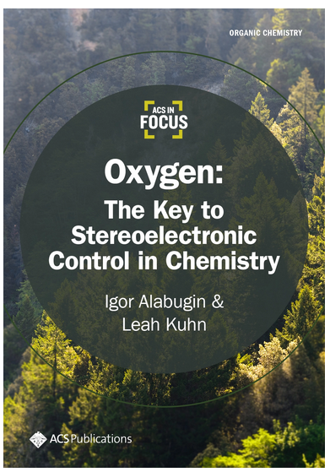
Everything you need to know about oxygen in organic molecules
Leah Kuhn
Back-to-back 2021 papers in Chem. Soc. Reviews (impact factor =55):
1. Anomeric Effect, Hyperconjugation and Electrostatics: Lessons from Complexity in a Classic Stereoelectronic Phenomenon.
2. Stereoelectronic Power of Oxygen in Control of Chemical Reactivity: the Anomeric Effect is not Alone
Notes:
As most of other talks on reactions, I will be asking the two eternal questions of chemistry. I always ask them and recently wrote a book where I tried to answer these questions to the best of my ability. But today I will narrow this talk to discussion of bond making and breaking in the context of cyclization reactions
The synergy of cyclizations and fragmentations – what does it mean? Two main questions in chemistry:
We will narrow the focus a little bit and concentrate on cycles (>90% of molecules that we know have a cycle!). Furthermore, most of molecules that we don’t know ALSO have a cycle
The importance of fragmentations –
Build conceptual bridges between different functional groups, adjust oxidation level, aromatize, remove directing groups after they have served their purpose, etc etc

Slide 5

Choosing the right path for alkyne cyclizations
solved
Stereoelectronic analysis supports exo-selectivity for radical cyclizations
For “endo” cyclizations,
stereoelectronic requirements need to be reversed (e.g., “LUMO umpolung” in EPNCs etc)
Kerry Gilmore,
University of Connecticut
(2020 ACS Green Chemistry Award)
Notes:
I will mostly talk about control of selectivity in this talk

Slide 6

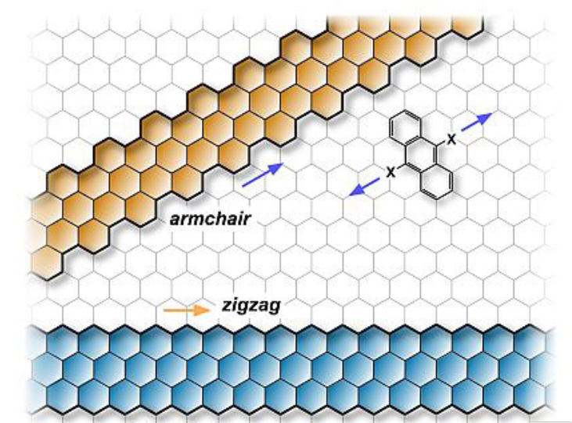
Playing Molecular Tetris - mostly with hexagons
Cyclic molecules can force desired electron delocalization patterns: by organizing space, we can organize energy
Müllen, Fasel and coworkers. Nature, 531, 489–492, 2016
There is more than one way to “cut” graphene into interesting substructures.
This can be useful as long as we can make these substructures with precise control of shapes and sizes
Notes:
We are playing molecular tetris with hexagons trying to make polyaromtic compounds, graphene substrucurtes of precise size and funcitonality

Slide 7


What can we make with hexagons?
No need to go far to find something unusual
Has no NMR signals
… but shows an EPR signal
Beginning of new technologies – as long as we can make these structures with precise control of shapes and sizes
t_{1/2} = 42 h;
S/T gap =
-0.3 kcal/mol
Febin Kuriakose
Michael Commodore
Kuriose, Commodore et al. J. Amer. Chem. Soc. 2022, 23448. https://pubs.acs.org/doi/10.1021/jacs.2c09637
Notes:
We are playing molecular tetris with hexagons trying to make polyaromtic compounds, graphene substrucurtes of precise size and funcitonality

Slide 8
Radicals and alkynes – a perfect combination?
Neutral reactive intermediates + carbon-rich high-energy functionality = fewer problems with overoxidation/ fewer hydrogens to remove
Two challenges –
understanding how alkynes can be used to form a cycle
understanding how radicals can be used efficiently and selectively in alkyne reactions
Mohamed, Mondal, Guerrera, Eaton, Albrecht-Schmitt, Shatruk, Alabugin, ACIE, 2016, 55, 12054
Notes:
I will mostly talk about control of selectivity in this talk

Slide 9
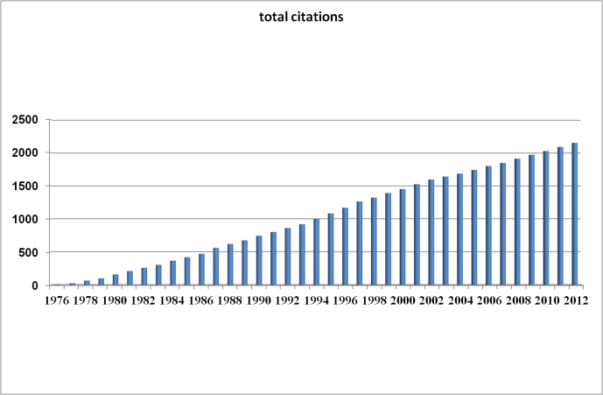
Refined cyclization rules (Baldwin rules)
X
Citations for the “Rules for Ring Closure” (1976-2012) – the most cited paper in the first 40 years of ChemComm
X
X
Baldwin, Chem. Commun. 1976, 734
The new rules reflect stereoelectro-nic control of organic reactivity

Slide 10
Let’s add aromatic spacers to oligoalkynes
Which of the two “alkyne origami” patterns to choose?
Topogically:
endo is preferred
Stereoelectronically:
Exo is preferred
Notes:
You need spacers to organize everything and, of course, benzene are natural spacers for the purpose of making polyaromatics

Slide 11
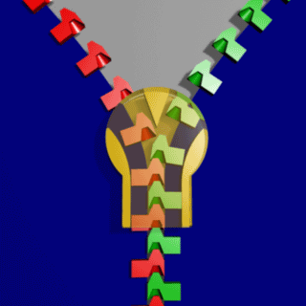
“To bend or not to bend”:
Simplifying the analysis of alkyne folding
The “all-exo” cascade
Can we make a polyacetylene chain between two rows of benzenes with this radical “polymerization”?
Notes:
Hint: ChemDraw makes it very easy
The original representation looked so difficult because I followed the undergraduate mantra “do not bend the triple bonds”
…
If you see the bent alkynes in this talk it is not because I don’t know that alkynes are linear but because I want to help you follow the structural design.

Slide 12
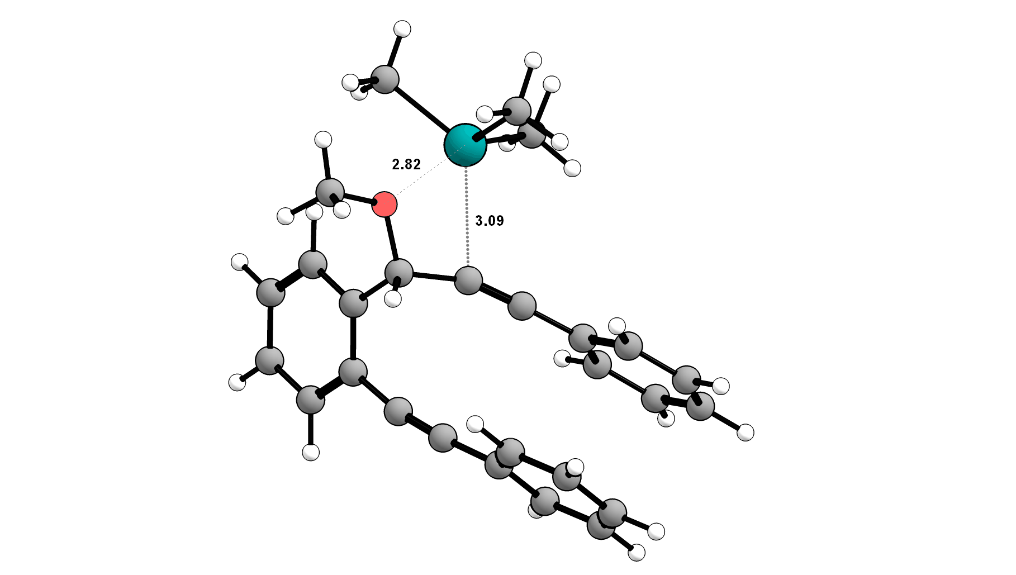

“Directing groups” for intermolecular control of reactivity?
What is the right combination that will create a transient but effective supramolecular X…DR “bond”?
O…Sn interaction
Gabriel dos Passos Gomes
K. Pati, G. Gomes, T. Harris, A. Hughes, H. Phan, T. Banerjee, K. Hanson, I. Alabugin, J. Am. Chem. Soc., 2015, 1165.

Slide 13
How many papers will you publish in grad school?
S. Umedu, G. P. Gomes, M. Sakae, T. Yoshinaga, K. Matsumoto, T. Iwata, I. Alabugin, M. Shindo "Regioselective One-pot Synthesis of Triptycenes via Triple-Cycloadditions of Arynes to Ynolates" Angew. Chem. Int. Ed., 2016, 56, 1298 (featured on: • Synfacts 2017, 13 (03), 253 “Three Benzynes and the Ynolate”, doi: 10.1055/s-0036-1590046)
S. Z. Vatsadze, Y. Loginova, G. P. Gomes, I. V. Alabugin "Stereoelectronic Chameleons: The Reversal of Donor-Acceptor Properties of Common Functional Groups by a Geometric Change" Chem. Eur. J., 2016, 23, 3225 (Frontspiece of Chemistry ­– A European Journal, doi: 10.1002/chem.201781461)
K. Pati, G. P. Gomes, I. V. Alabugin "Combining Traceless Directing Groups with Hybridization Control of Radical Reactivity: from Skipped Enynes to Defect-Free Hexagonal Frameworks" Angew. Chem. Int. Ed., 2016, 55, 11633
T. Harris, G. P. Gomes, R. Clark, I. V. Alabugin, "Domino Fragmentations in Traceless Directing Groups of Radical Cascades: Evidence for the Formation of Alkoxy Radicals via C-O Scission" J. Org. Chem., 2016, 81 (14), 6007 (featured on: • sciencing.net)
K. Pati, G. P. Gomes, T. Harris, I. V. Alabugin "Fused Catechol Ethers from Gold (I)-Catalyzed Intramolecular Reaction of Propargyl Ethers with Acetals" Org. Lett., 2016, 18 (5), 928
G. P. Gomes, V. A. Vil’, A. Terent’ev and I. V. Alabugin, "Stereoelectronic Source of the Anomalous Stability of Bis-peroxides", Chem. Sci., 2015, 6, 6783 (featured on: • Chemistry World; • NBO’s features website; • chem.fsu.edu/News)
K. Pati, G. P. Gomes, T. Harris, A. Hughes, H. Phan, T. Banerjee, K. Hanson, I. V. Alabugin "Traceless Directing Groups in Radical Cascades: From Oligoalkynes to Fused Helicenes without Tethered Initiators" J. Am. Chem. Soc., 2015, 137, 1165
I. V. Alabugin, S. Bresch, G. P. Gomes "Orbital Hybridization: A Key Electronic Factor in Control of Structure And Reactivity" J. Phys. Org. Chem., 2014, 28, 147 (one of the most accessed papers on: • JPOC between 10/2015-09/2016 & 02/2016-08/2017 • department’s most read paper on ResearchGate in October–November 2017; featured on: • amphoteros.com)

Slide 14
How many papers will you publish in grad school?
11. S. Umedu, G. P. Gomes, M. Sakae, T. Yoshinaga, K. Matsumoto, T. Iwata, I. Alabugin, M. Shindo "Regioselective One-pot Synthesis of Triptycenes via Triple-Cycloadditions of Arynes to Ynolates" Angew. Chem. Int. Ed., 2016, 56, 1298 (featured on: • Synfacts 2017, 13 (03), 253 “Three Benzynes and the Ynolate”, doi: 10.1055/s-0036-1590046)
10. S. Z. Vatsadze, Y. Loginova, G. P. Gomes, I. V. Alabugin "Stereoelectronic Chameleons: The Reversal of Donor-Acceptor Properties of Common Functional Groups by a Geometric Change" Chem. Eur. J., 2016, 23, 3225 (Frontspiece of Chemistry ­– A European Journal, doi: 10.1002/chem.201781461)
9. K. Pati, G. P. Gomes, I. V. Alabugin "Combining Traceless Directing Groups with Hybridization Control of Radical Reactivity: from Skipped Enynes to Defect-Free Hexagonal Frameworks" Angew. Chem. Int. Ed., 2016, 55, 11633
8. T. Harris, G. P. Gomes, R. Clark, I. V. Alabugin, "Domino Fragmentations in Traceless Directing Groups of Radical Cascades: Evidence for the Formation of Alkoxy Radicals via C-O Scission" J. Org. Chem., 2016, 81 (14), 6007 (featured on: • sciencing.net)
6. K. Pati, G. P. Gomes, T. Harris, I. V. Alabugin "Fused Catechol Ethers from Gold (I)-Catalyzed Intramolecular Reaction of Propargyl Ethers with Acetals" Org. Lett., 2016, 18 (5), 928
5. G. P. Gomes, V. A. Vil’, A. Terent’ev and I. V. Alabugin, "Stereoelectronic Source of the Anomalous Stability of Bis-peroxides", Chem. Sci., 2015, 6, 6783 (featured on: • Chemistry World; • NBO’s features website; • chem.fsu.edu/News)
2. K. Pati, G. P. Gomes, T. Harris, A. Hughes, H. Phan, T. Banerjee, K. Hanson, I. V. Alabugin "Traceless Directing Groups in Radical Cascades: From Oligoalkynes to Fused Helicenes without Tethered Initiators" J. Am. Chem. Soc., 2015, 137, 1165
1. I. V. Alabugin, S. Bresch, G. P. Gomes "Orbital Hybridization: A Key Electronic Factor in Control of Structure And Reactivity" J. Phys. Org. Chem., 2014, 28, 147 (one of the most accessed papers on: • JPOC between 10/2015-09/2016 & 02/2016-08/2017 • department’s most read paper on ResearchGate in October–November 2017; featured on: • amphoteros.com)

Slide 15
How many papers will you publish in grad school?
25. G. P. Gomes & I. V. Alabugin "Stereoelectronic Effects: Analysis by Computational and Theoretical Methods", chapter 15 for the book "Applied Theoretical Organic Chemistry" Editor: Prof. Dean Tantillo (UC-Irvine), 2018.
23. N. P. Tsvetkov, E. Gonzalez-Rodriguez, A. Hughes, G. P. Gomes, F. D. White, I. V. Alabugin “Radical Alkyne Peri-annulations for Synthesis of Functionalized Phenalenes, Benzanthrenes, and Olympicene”, Angew. Chem. Int. Ed., 2018, in print, doi: 10.1002/anie.201712783 (• Top 5% of ACIE’s output. Featured on FSU News, reproduced on: • phys.org; • nsf.gov/news; • sciencedaily.com; • EurekAlert!)
22. V. A. Vil’, G. P. Gomes, O. V. Bityukov, M. A. Syroeshkin, K. A. Lyssenko, G. I. Nikishin, I. V. Alabugin. A. O. Terent’ev “Interrupted Baeyer-Villiger Rearrangement: Building A Stereoelectronic Trap for the Criegee Intermediate”, Angew. Chem. Int. Ed., 2018, in print, doi: 10.1002/anie.201712651. (• Top 5% of ACIE’s output. Featured on: • Chemical & Engineering News)
20. C. J. Evoniuk, G. P. Gomes, S. Hill, F. Satoshi, I. V. Alabugin "Coupling C-H activation, N-H deprotonation and Oxidation: metal-free C(sp³)-H aminations with unprotected anilines" J. Am. Chem. Soc., 2017, 139 (45), 16210 (featured on: • Synfacts 2018, 14 (02), 144 “Expanded N-Heterocycles through C(sp³)–H Amination”; • in the top 20 most-read JACS papers in Oct-Nov 2017)
19. T. Harris, G. P. Gomes, R. Clark, S. Ayad, V. V. Lobodin, K. Hanson, I. V. Alabugin "Twisted chiral cyclodecynes and remote activation of click reactivity" Chem, 2017, 3 (4), 629 (• video-summary of the paper. Featured on: • FSU News)
18. N. H. Park, G. P. Gomes, M. Fevre, G. O. Jones, I. V. Alabugin, J. L. Hedrick, "Organocatalyzed Synthesis of Fluorinated Poly(aryl thioethers)" Nature Communications, 2017, 8, 166; (a collaboration with IBM Research, San Jose, CA. Featured on: • Plastic News; • Synfacts 2017, 13 (10), 1035 “Salt-Free Polymerization Yields Fluorinated Poly(aryl thioether)s”)
17. E. Juaristi, G. P. Gomes, A. O. Terent’ev, R. Notario, I. V. Alabugin "Stereoelectronic Interactions as a Probe for the Existence of the Intramolecular α-Effect", J. Am. Chem. Soc., 2017, 139 (31), 10799
15. G. P. Gomes§, C. J. Evoniuk§, M. Ly, I. V. Alabugin "Changing the path of least resistance, or access to endo-dig products via a sequence of three exo-trig transition states: electronic effects in homoallyic ring expansion cascades of alkenyl isonitriles" Org. Biom. Chem., 2017, 15, 4135
13. G. P. Gomes§, Y. A. Yaremenko§, P. S. Radulov, R. A. Novikov, V. V. Chernyshev, A. A. Korlyukov, G. I. Nikishin, A. O. Terent’ev, I. V. Alabugin "Stereoelectronic Control in the Ozone-Free Synthesis of Ozonides" Angew. Chem. Int. Ed., 2017, 56, 4955
12. G. P. Gomes & I. V. Alabugin "Drawing Catalytic Power from Charge Separation: Stereoelectronic and Zwitterionic Assistance in the Au(I)-Catalyzed Bergman Cyclization" J. Am. Chem. Soc., 2017, 139 (9), 3406
Less than four years since starting his PhD

Slide 16
How many papers will you publish in grad school?
32-42…Were also published (one more is under review)
31. A. Hughes, G. P. Gomes, I. V. Alabugin, Stereoelectronic Influence of a “Spectator” Propargylic Substituent Can Override Aromaticity Effects in Radical Peri-cyclizations on Route to Expanded Polyaromatics, J. Org. Chem., 2019, 84, 1853
30. CO₂ or SO₂: Should it stay or should it go? Gomes, G.; Wimmer, A.; Smith, J.; König, B.; Alabugin, I.V. J. Org. Chem., 2019, 84, 6232-6243.
29. V. A. Vil’, G. P. Gomes, M. V. Ekimova, K. A. Lyssenko, G. I. Nikishin, I. V. Alabugin, A. O. Terent’ev “From transient Bayer-Villiger (Criegee) intermediate to stable peroxides: BF3-catalyzed synthesis of β-hydroperoxy-β-peroxylactones from five different types of substrates”, J. Org. Chem., 2018, 83, 13427–13445
28. G. P. Gomes, Y. Loginova, S. Z. Vatsadze, I. V. Alabugin "Isocyanides as Stereoelectronic Chameleons: The Donor-Acceptor Dichotomy in Radical Additions", J. Am. Chem. Soc. 2018, 140, 14272-14288.
27. G. P. Gomes, A. E. Morrison, G. B. Dudley, I. V. Alabugin "Optimizing amine-mediated alkyne-allene isomerization to improve benzannulation cascades: synergy between theory and experiments", Eur. J. Org. Chem., 2019, 512-518.
26. I. V. Alabugin, G. P. Gomes, M. Abdo, "Hyperconjugation", WIREs Comput. Mol. Sci., 2019, doi/full/10.1002/wcms.1389.

Slide 17
Non-planar aromatics from skipped alkynes
Helicenes:
enantiomerically pure crystals
Pati, K.; Gomes, G. P.; Harris, T.; Hughes, A.; Phan, H.; Banerjee, T.; Hanson, K.; Alabugin, I. V. JACS, 2015, 1165.
More on why this cascade works so well:
Design principles of the use of alkynes in radical cascades. C. Hu, J. Mena, I.V. Alabugin,
Nature Reviews Chemistry, 2023, https://www.nature.com/articles/s41570-023-00479-w.

Slide 18
Fun with helicenes: how to make graphene chiral?
Zheng Zhou, Rahul Kisan Kawade, Renana Gershoni-Poranne, Zheng Wei, Febin Kuriakose, Marina A. Petrukhina, and Igor V. Alabugin, Angew.Chem., 2020

Slide 19
Fun with helicenes: how to make graphene anionic?
Zheng Zhou, Rahul Kisan Kawade, Renana Gershoni-Poranne, Zheng Wei, Febin Kuriakose, Marina A. Petrukhina, and Igor V. Alabugin, Angew.Chem., 2020

Slide 20
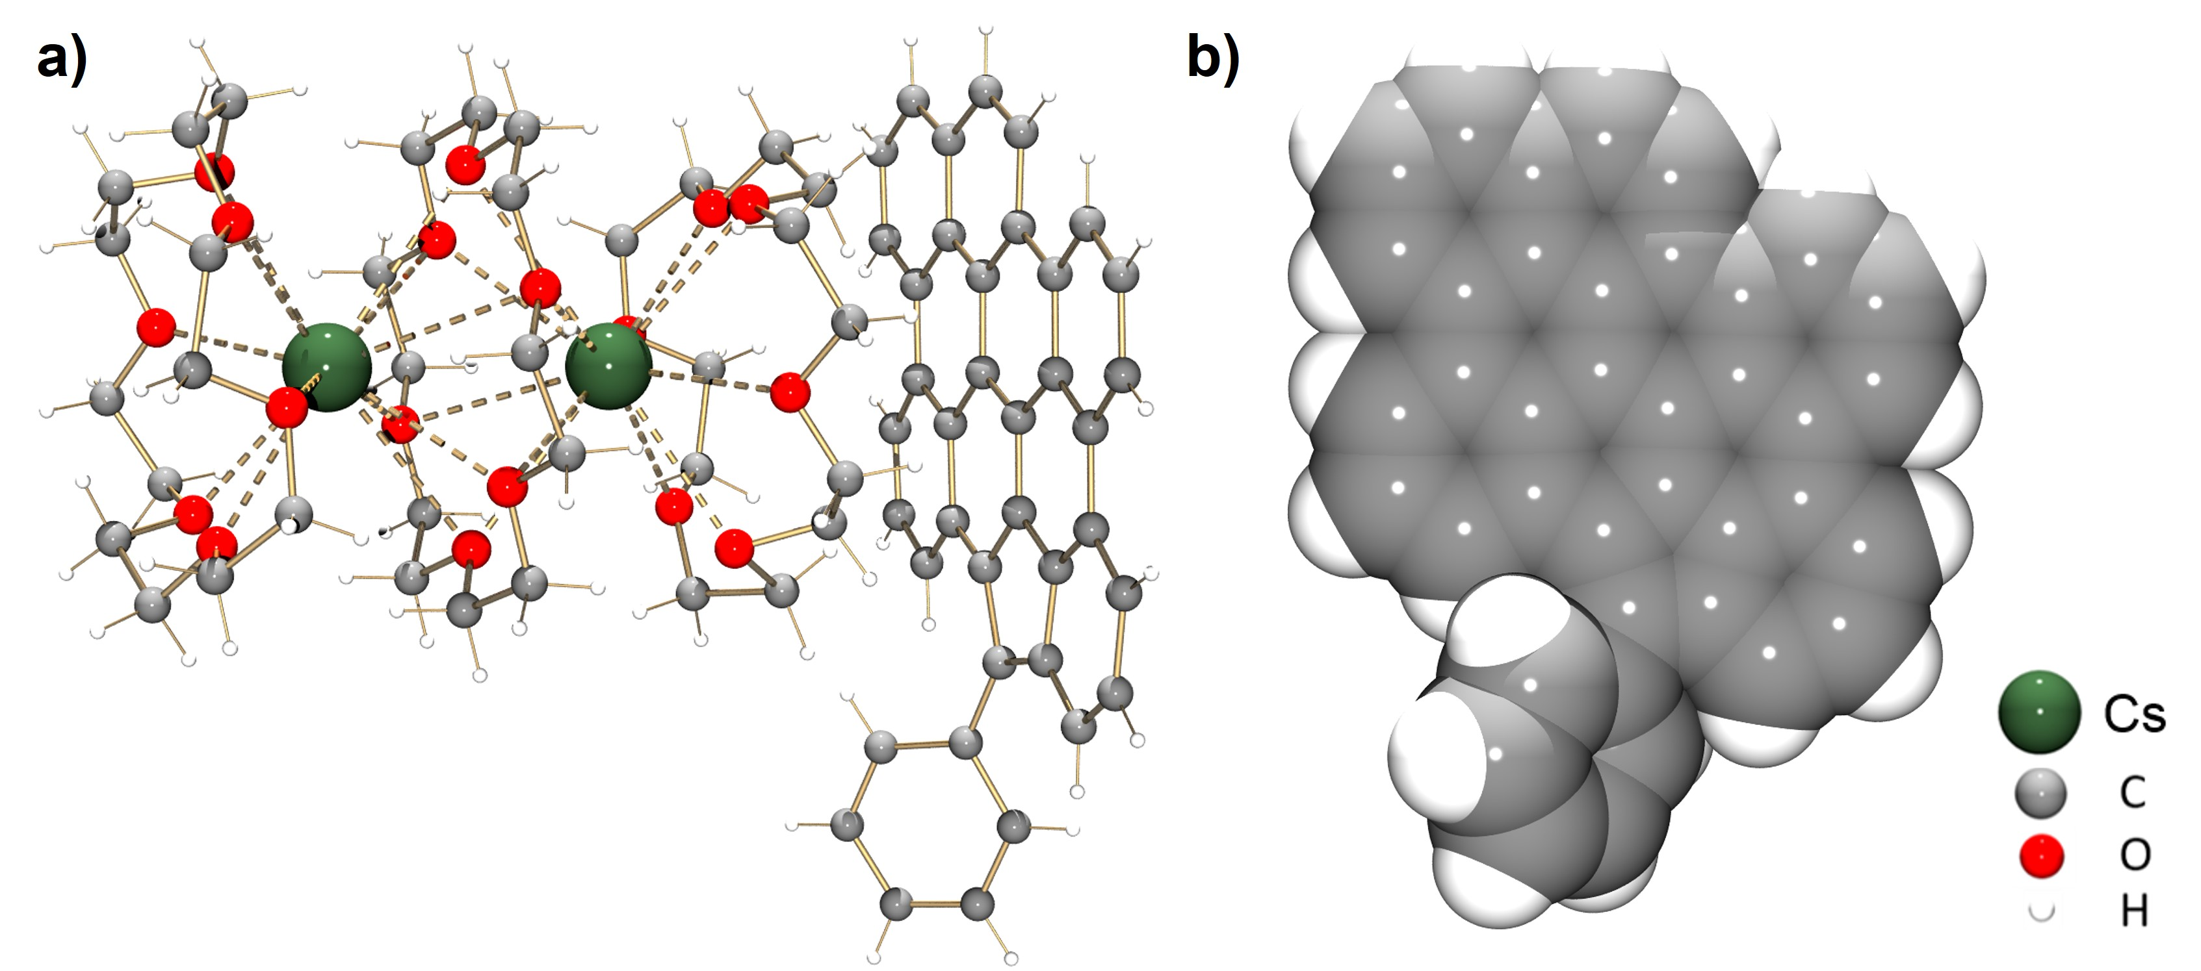
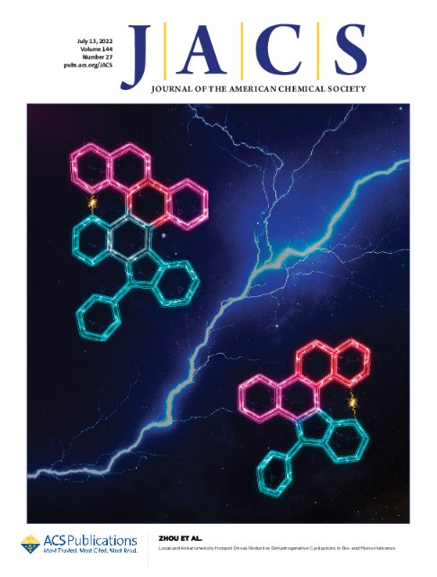
Towards a new form of carbon?
X-ray structures

Slide 21
Phenalenannulations: “three-point” double annulation reactions that convert benzenes into pyrenes
How to build polycyclic structures faster?
Kawade, R. K., Hu, C. W.; Dos Santos N. R., Watson, N., Lin, X., Hanson, K.; Alabugin, I. V. Angew.Chem. Int. Ed. 2020, 59, 14352-14357.
Notes:
Как быстрее строить полициклические молекулы?

Slide 22
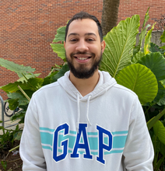
Scope of 3-point double annulations: design #2
a) KOtBu (1.4 equiv.), THF; b) i) [9a] 0.02 M, Bu₃SnH (1.3 equiv.), AIBN (0.3 equiv.), toluene, 90ºC, ii) Bu₃SnH (3.0 equiv.), AIBN (2.0 equiv.), 110ºC iii) I₂ (5.0 equiv.), DCM; isolated yields are reported from 9 to 10
Ask Nik Dos Santos how to do it without Bu₃SnH, AIBN and any other chemicals!
Kawade, R. K., Hu, C. W.; Dos Santos N. R., Watson, N., Lin, X., Hanson, K.; Alabugin, I. V. Angew.Chem. Int. Ed. 2020, 59, 14352-14357

Slide 23
Tired of carbon?
How about a new way to make C-N bonds?

Slide 24
Reinventing C-H aminations

Slide 25


How to fix thermodynamics of C-H aminations
Experiments:
Chris Evoniuk
Evoniuk, C. J.; Gomes, G. dos P.; Hill, S. P.; Fujita, S.; Hanson, K.; Alabugin, I.V. J. Am. Chem. Soc. 2017, 139, 16210
Calculations:
Gabe Gomes
(SMD=DMF)/(U)M06-2X(D3)/6-31+G(d,p)/int=ufine, kcal/mol

Slide 26
A milder approach to C-H aminations: the base/radical/oxidant trio
Evoniuk, C. J.; Hill, S. P.; Hanson, K.; Alabugin, I. V. Chem. Commun. 2016, 52, 7138
Need a build-up of reduction potential
Evoniuk, C. J.; Gomes, G. dos P.; Hill, S. P.; Fujita, S.; Hanson, K.; Alabugin, I.V. J. Am. Chem. Soc. 2017, 139, 16210

Slide 27
N-heterocycles twist and bend
Evoniuk, C. J.; Gomes, G. dos P.; Hill, S. P.; Fujita, S.; Hanson, K.; Alabugin, I.V. J. Am. Chem. Soc. 2017, 139, 16210

Slide 28
What is the smallest possible catalyst?
Electron?
Or hole?

Slide 29
A new concept
Electron upconversion
Can we figure out how to build this black box?
Notes:
and I hope that this will stay that way and that there will always be something new that I don’t have time to tell you about

Slide 30
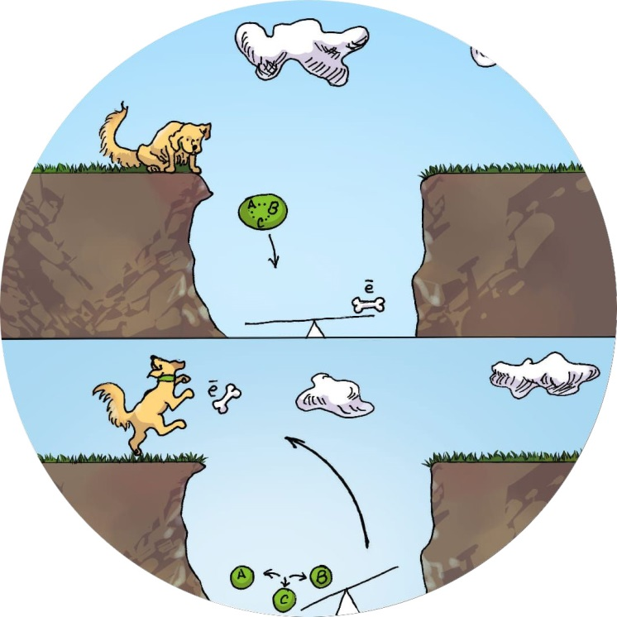
Electron upconversion is possible
…and you can be find a way to make it useful!
Angew. Chem. Int. Ed., 2019, 57, 5532
Notes:
and I hope that this will stay that way and that there will always be something new that I don’t have time to tell you about

Slide 31

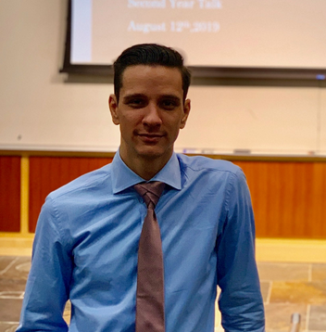
Expanding the scope of three-electron approach to C-N bond formation
6-membered aromatic heterocycles
Chris Evoniuk
5-membered non-aromatic heterocycles
Quintin Elliott
a 10-million-fold decrease in basicity of N-anion
Why is it interesting?
Because it hides a paradox
Evoniuk, C. J.; Gomes, G. dos P.; Hill, S. P.; Fujita, S.; Hanson, K.; Alabugin, I.V. J. Am. Chem. Soc. 2017, 139, 16210. Q. Elliott, G. Gomes, C. J. Evoniuk, I. V. Alabugin, Chem. Science, 2020, 11, 6539
Level of theory: (SMD=DMF)/(U)M06-2X(D3)/6-31+G(d,p)/int=ufine
Notes:
In the present work, we have increased N–H bond acidity by seven orders of magnitude from our earlier studies by switching from aniline (pK_{a} ∼ 30 in DMSO) to amides (pK_{a} ∼ 23 in DMSO). Such deactivation of the conjugated nitrogen base increases the activation barrier for C–N bond formation from 8.5 to 17.2 kcal mol⁻¹ and decreased reaction exergonicity from 28¹⁰ to 4 kcal mol⁻¹. Thus, the present use of a stabilized N-anion provided important “bracketing” information on the thermodynamic limits of three-electron C–N bond formation.

Slide 32

The smallest catalyst for the Diels-Alder reaction
ACM SIGHPC Computational and Data Science Fellowship (2023)
Beauty Chabuka
Hole Catalysis of Pericyclic Reactions: How to Activate and Control Oxidant Upconversion in Radical-Cationic Diels-Alder Cycloaddition. Beauty Chabuka, Igor Alabugin, JACS, in print
Level of theory: (SMD=DMF)/(U)M06-2X(D3)/6-31+G(d,p)/int=ufine
Notes:
In the present work, we have increased N–H bond acidity by seven orders of magnitude from our earlier studies by switching from aniline (pK_{a} ∼ 30 in DMSO) to amides (pK_{a} ∼ 23 in DMSO). Such deactivation of the conjugated nitrogen base increases the activation barrier for C–N bond formation from 8.5 to 17.2 kcal mol⁻¹ and decreased reaction exergonicity from 28¹⁰ to 4 kcal mol⁻¹. Thus, the present use of a stabilized N-anion provided important “bracketing” information on the thermodynamic limits of three-electron C–N bond formation.

Slide 33
Collaborations
2016-2023:
Visiting students: Sweden, Germany, Mexico, Brazil, Russia, Spain
Coauthors in published papers: Sweden, Japan, Australia, Germany, Russia, Mexico, Spain, Iran, India, Czech Republic, Wales, France

Slide 34
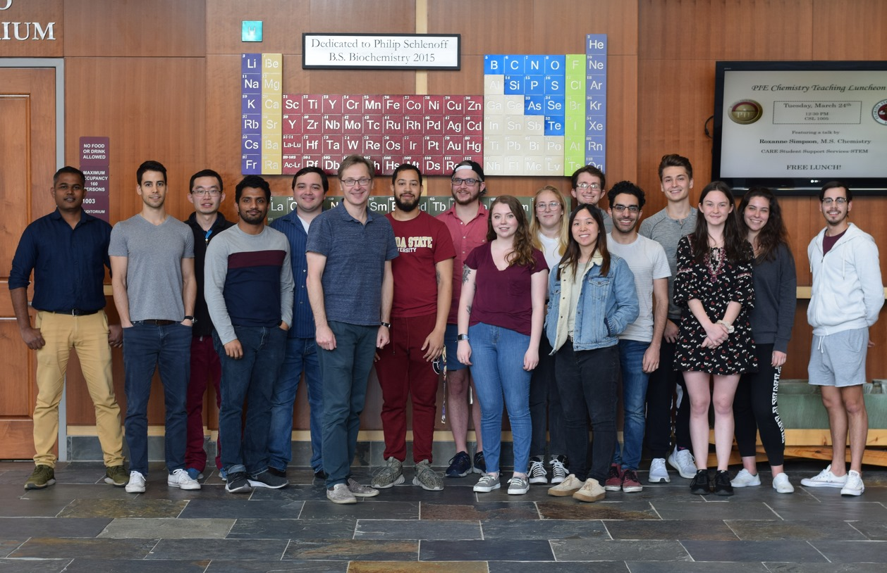
The A-Group
Alumni: Dr. Kerry Gilmore, Dr. Phil Byers, Dr. Paul Peerson, Dr. Brian Gold, Dr. Sayantan Mondal, Dr. Kishore Pati, Dr. Nikolay Tsvetkov, Dr. Rana Mohamed, Dr. Stefan Bresch, Dr. Dinesh Vidhani, Dr. Trevor Harris, Dr. Chris Evonyuk, Dr. Audrey Hughes, Dr. Gabriel dos Passos Gomes, Dr. Edgar Rodriguez-Gonzalez, Dr. Rahul Kawade, Dr. Febin Kuriakose, Dr. Quintin Elliott, Dr. Chaowei Hu, Dr. Daria Tonkoglazova, Dr. Antony Sekar, Dr. Leah Kuhn
Graduate students/Postdocs: Nik Dos Santos, Beauty Chabuka, Michael Commodore, Favour Makurvet, Kimberley Christopher
Undergrads (out of >180): Jahbari Bowen, Joshua Loewenstern, Ian Vallari, Christopher Rincon, Devon Nobrega, Gage Bayliss, Thomas Suarez, Airionna Fordham
$$$: NSF, FSU, ACS Cope Scholar Fund

